Slide 1
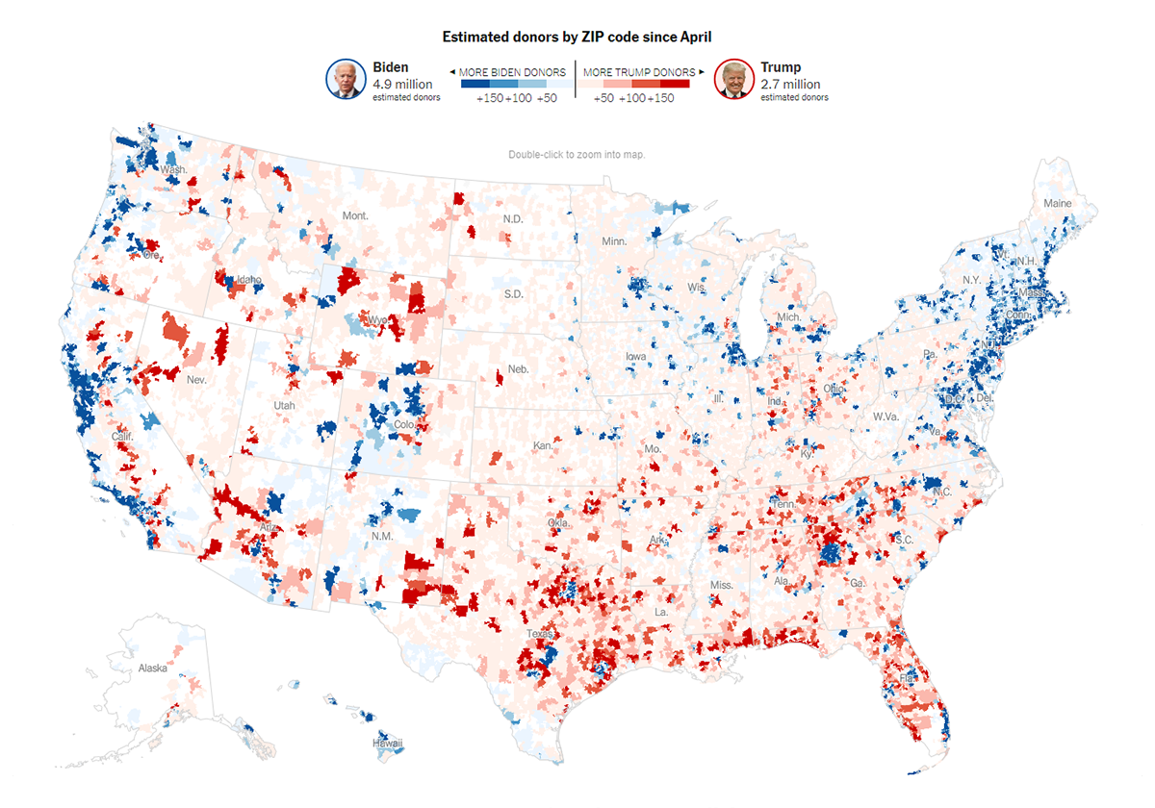
US campaign
Finance
Analytics
By
Harshitha Yentrapragada
Udveg Jukanti
Shivani Badinehal

Slide 2
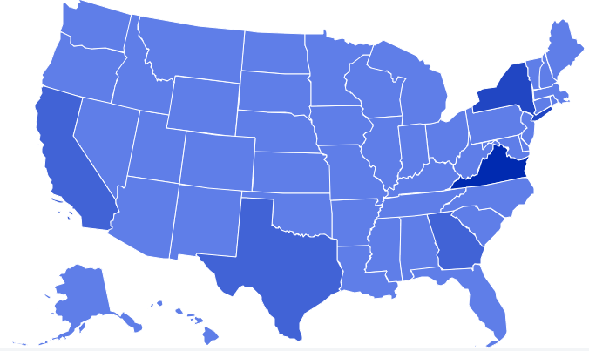
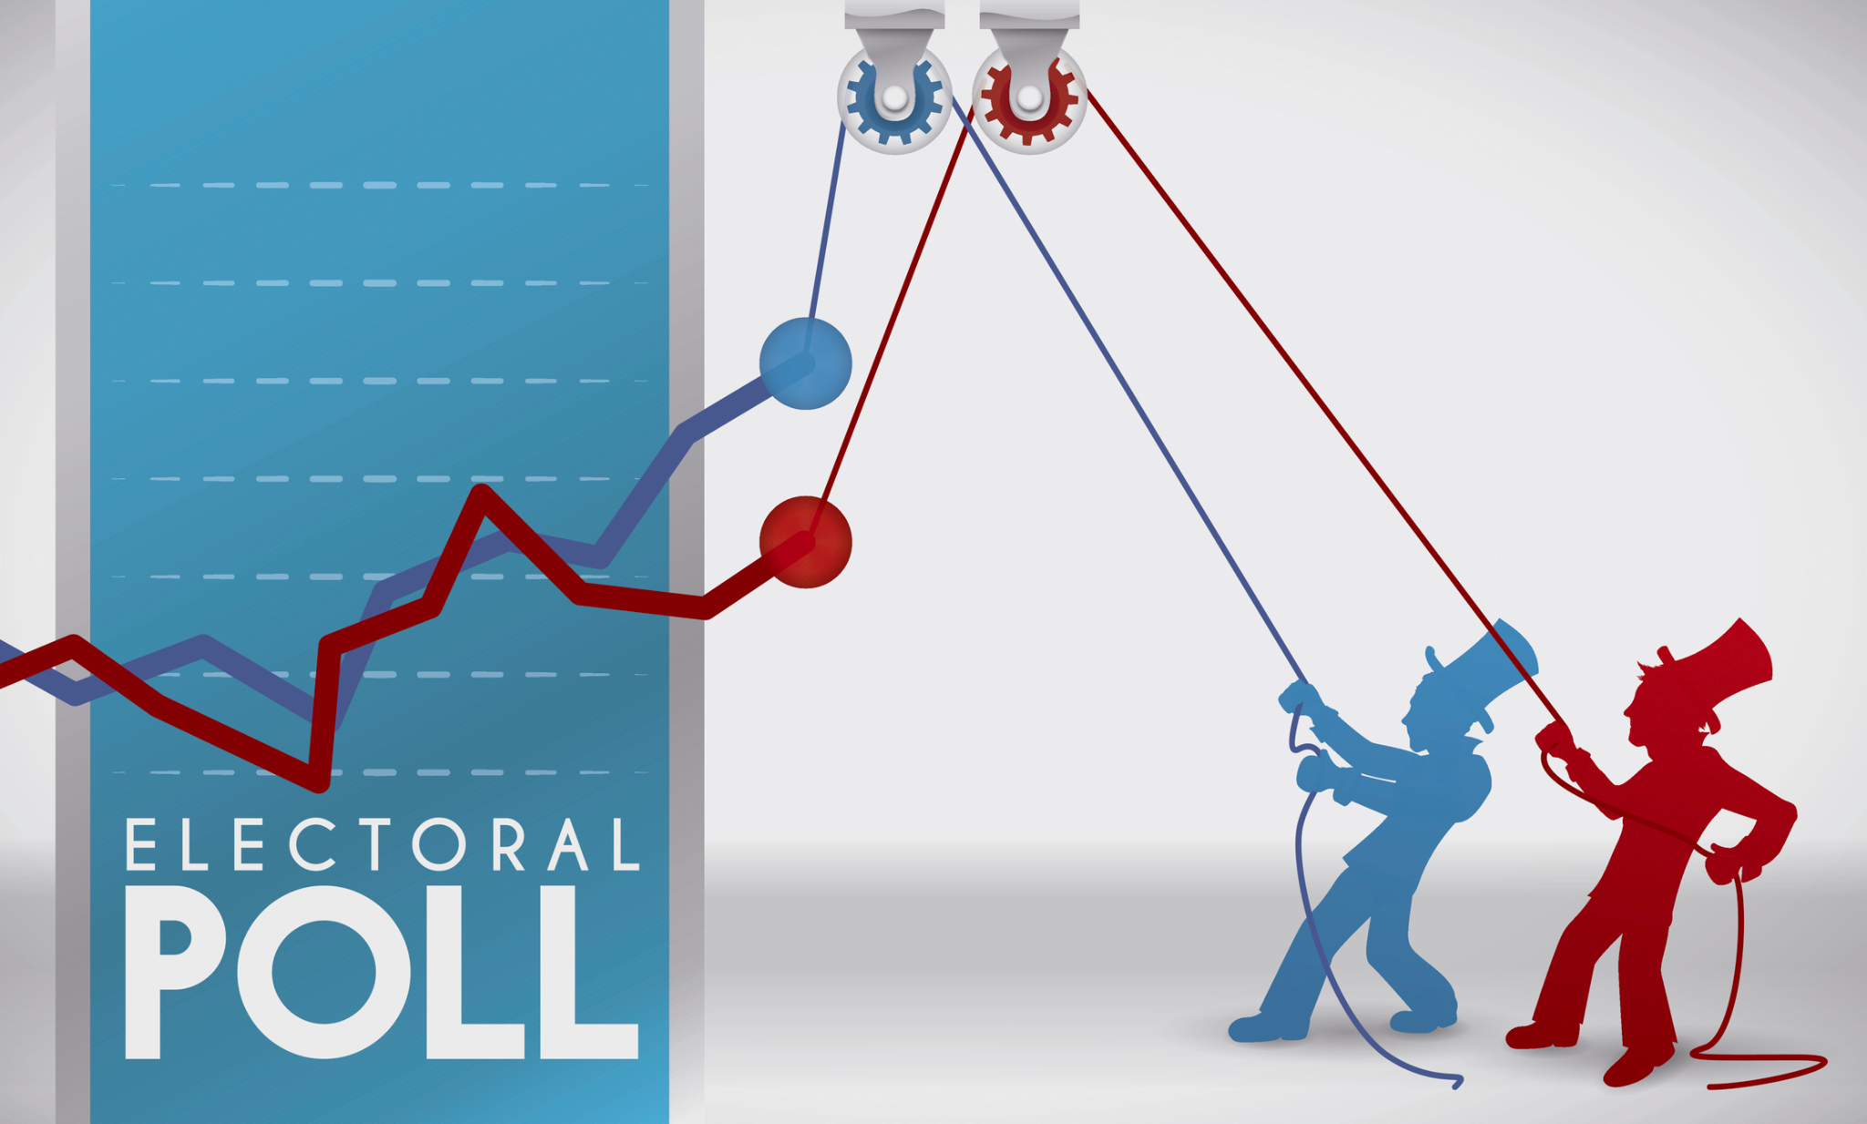
How Can We apply Machine Learning on US Campaign Data
Machine learning can be used on US campaign data to analyze and predict various aspects of the campaign, such as voter behavior, preferences, and turnout. Some of the ways in which machine learning can be applied to campaign data include:
Voter segmentation: Machine learning algorithms can analyze voter data to identify patterns and segment voters based on their demographics, voting history, and other factors. This can help campaigns to tailor their messaging and outreach to specific groups of voters.
Predictive modeling: Machine learning algorithms can be used to build predictive models that can forecast voter behavior, such as voter turnout or which candidate a voter is likely to support. This can help campaigns to allocate resources more effectively and target their outreach efforts to the voters who are most likely to be swayed.
Find out the relation between the characteristics of the population and the number of votes of Democratic and Republican.

Slide 3
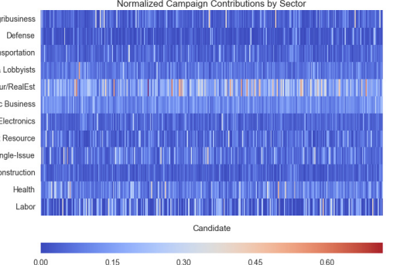
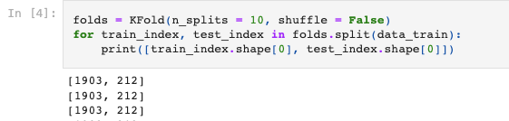
Progress
Feature Selection :-
Campaign finance data for a set of candidates (as determined by sampling from the DW-NOMINATE scores) was obtained using the available data in one of the Table. Of the available data, we chose to partition finance streams by sector. For each sector, individual and contributions were combined and normalized on a per candidate basis. A heatmap of the total feature set is illustrated below.
In order to evaluate the structure of the feature data set, PCA was performed on the above matrix. It appears the financial, and labor sectors specify the dimensions of largest variance.
Then this data was splitted and used further by either splitting the data or we also used cross validation method such as K-Fold.
As there was various year data present identifying the data to actually use for ML was challenging.

Slide 4
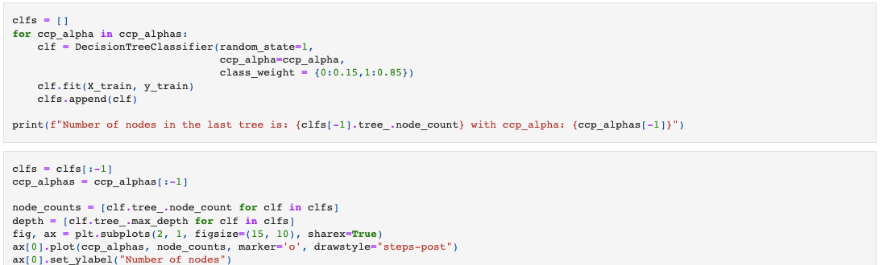
Initial ML Models
Build Initial Decision Tree Model
We will build our model using the DecisionTreeClassifier function. Using default 'gini' criteria to split.
If the frequency of class A is 10% and the frequency of class B is 90%, then class B will become the dominant class and the decision tree will become biased toward the dominant classes.
So the challenge here was even with the frequency set to 40 and 50% it was still resulting higher accuracy because of Overfitting. As the model analyzed and captured data of previous year which had data discrepancy it failed to capture actual pattern in data which lead to poor performance.
Solution:-
Pruning - We tried to perform pruning which will prevent tree to grow full depth. However we are still trying to fit the model to current data.

Slide 5
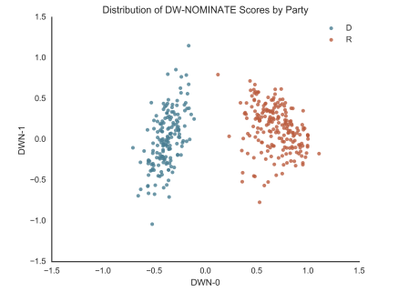
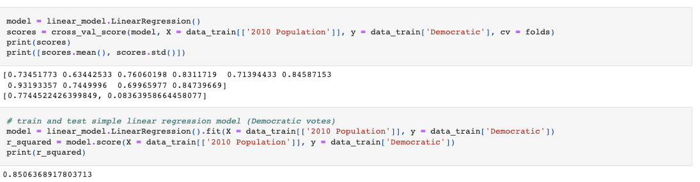
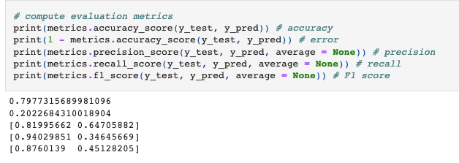
Current Progress:-
Currently we have started working on data which is more inclined towards predicting such as finding out the relation between the characteristics of the population and the number of votes of Democratic and Republican.
As we also wanted to check how people will vote, for example to either Democratic or Republican we performed classification method. Here

Slide 6
Conclusion
I analyzed the "Voting probability" using different techniques and used a Decision Tree Classifier to build a predictive model.
The predictive model linear regression to predict number of votes of Democratic.
Currently working on Classification techniques like SVM and KNN to predict the type of people who will vote for different parties based on this we can find the winning party.
We established the importance of hyper-parameters/pruning to reduce overfitting during the model selection process.

Slide 7


